Slide 1
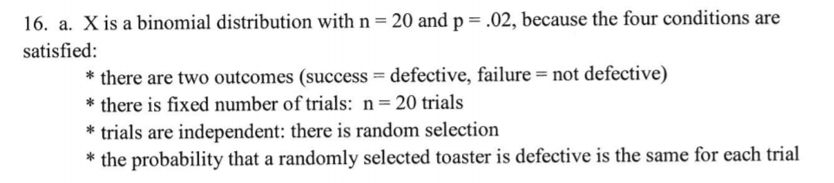
22.a.
We can expect to have to repair our mp3 player once over its lifetime, but that vary on average by 1 repair typically.
b.
We expect to have to perform 3 repairs, total, on our devices over their lifetimes, but that amount can vary on average by about 1.562 repairs typically.

Slide 2
Geometric Distribution

Slide 3
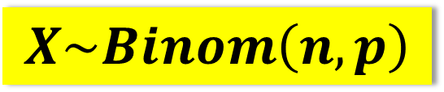
Binomial Random Variable
Geometric Random Variable
X = the number of 6’s after 12 rolls of fair die
Y = the number of rolls
until get 6 on fair die
How many successes in finite number of trials?
How many trials until success?
$$X\sim Binom\left(n,p\right)$$
Binary?
Outcomes of each trial: Success or failure?
☺
☺
Independent?
☹
Fixed number of trials?
☺
Same probability on each trial?

Slide 4
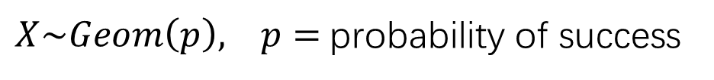
Def.
Suppose an experiment consists of a sequence of trials with the following conditions:
The trials are independent.
Each trial can result in one of two possible outcomes, success and failure.
The probability of success is the same for all trials.
A geometric random variable is defined as:
X = the number of trials until the first success is observed
(including the success trial)
The probability distribution of X is called the geometric probability distribution.
$X\sim Geom\left(p\right), p=$probability of success

Slide 5
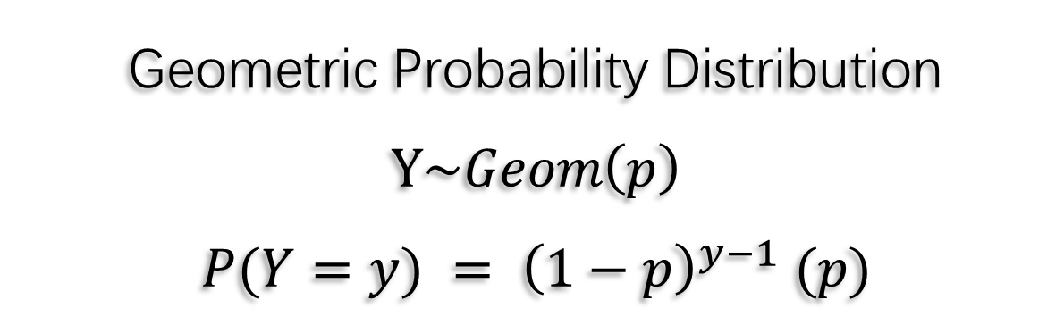
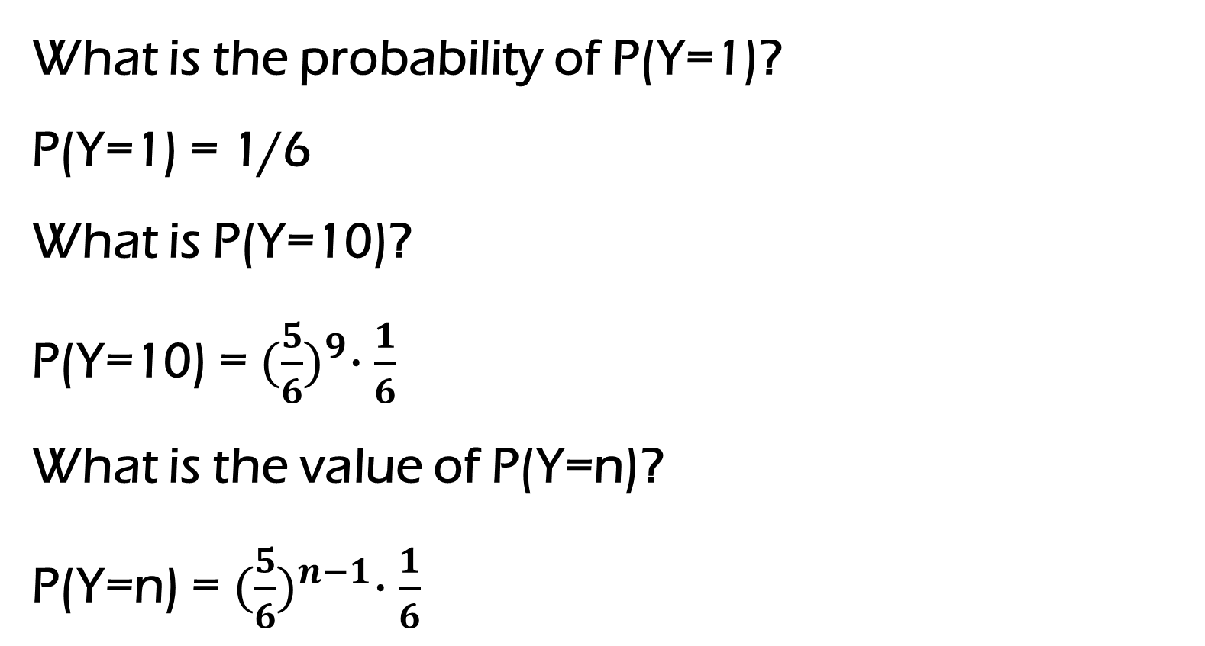
Y = the number of rolls until get 6 on fair die
What is the probability of P(Y=1)?
P(Y=1) = 1/6
What is P(Y=10)?
P(Y=10) = ${(\frac{5}{6})}^{9}∙\frac{1}{6}$
What is the value of P(Y=n)?
P(Y=n) = ${(\frac{5}{6})}^{n−1}∙\frac{1}{6}$
Geometric Probability Distribution
$$Y\sim Geom\left(p\right)$$
$$P(Y=y) = {\left(1−p\right)}^{y−1} (p)$$

Slide 6
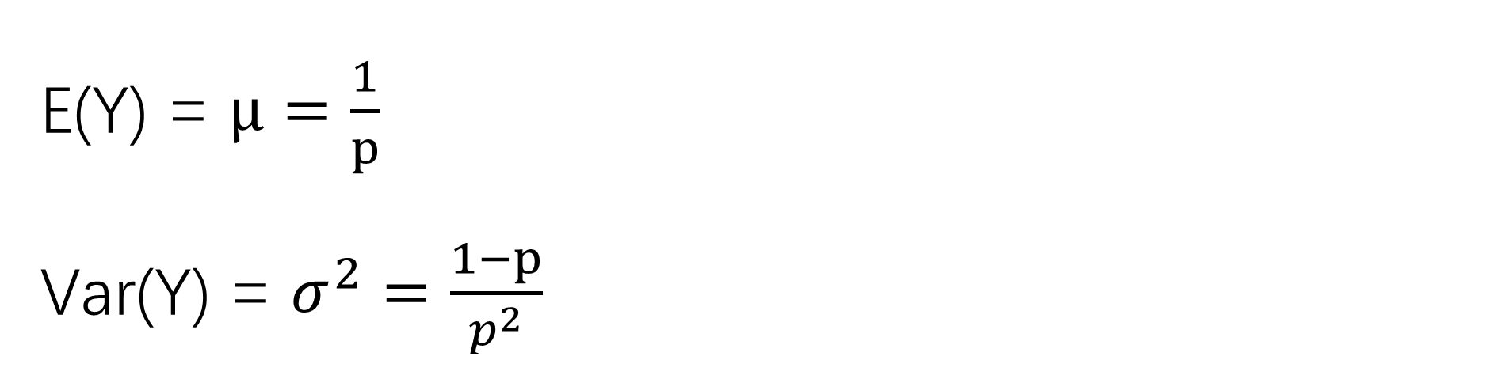
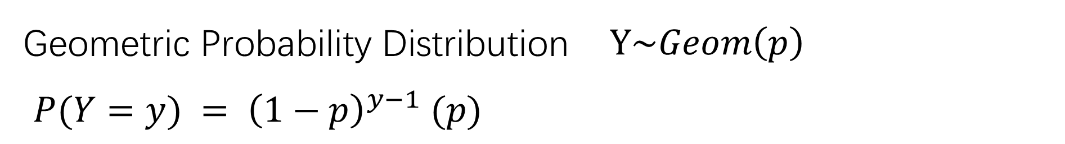
Geometric Probability Distribution $Y\sim Geom\left(p\right)$
$P(Y=y) = {\left(1−p\right)}^{y−1} (p)$
E(Y) = $μ=\frac{1}{p}$
Var(Y) = $σ^{2}=\frac{1−p}{p^{2}}$

Slide 7
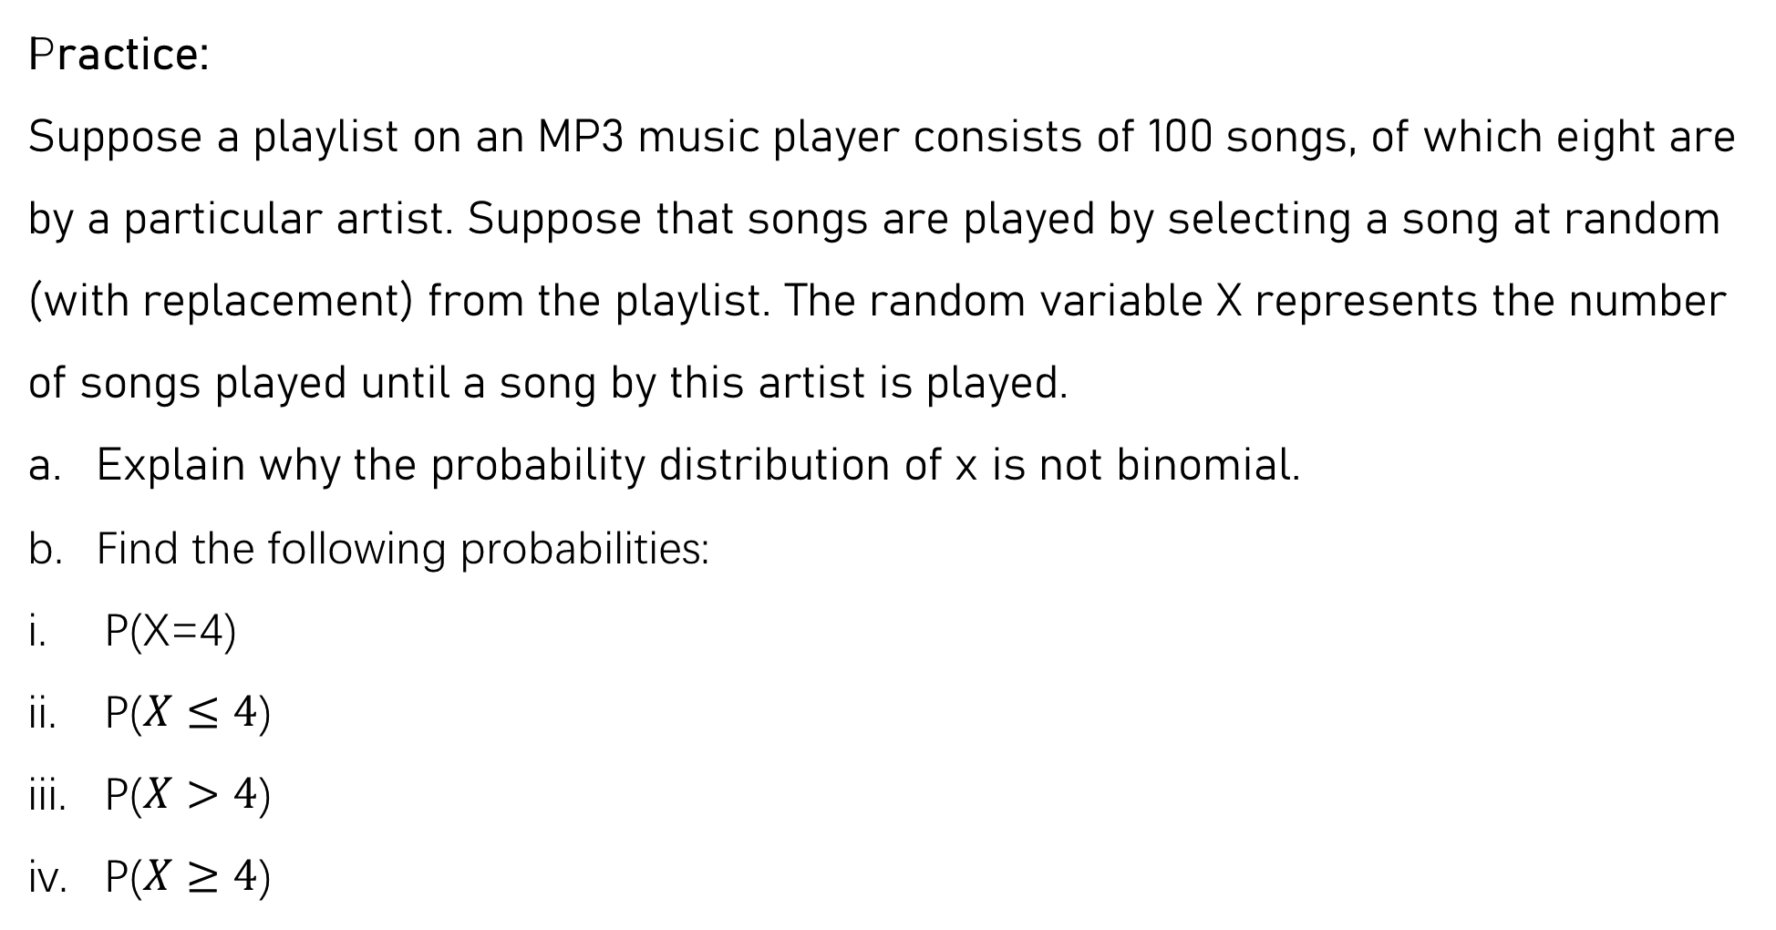
Practice:
Suppose a playlist on an MP3 music player consists of 100 songs, of which eight are by a particular artist. Suppose that songs are played by selecting a song at random (with replacement) from the playlist. The random variable X represents the number of songs played until a song by this artist is played.
Explain why the probability distribution of x is not binomial.
Find the following probabilities:
P(X=4)
P($X≤4$)
P($X>4$)
P($X≥4$)
There is not a fixed number of trials.
(We do not know the number of trials in advance.)
= 0.062
= 0.284
= 0.716
= 0.779

Slide 8
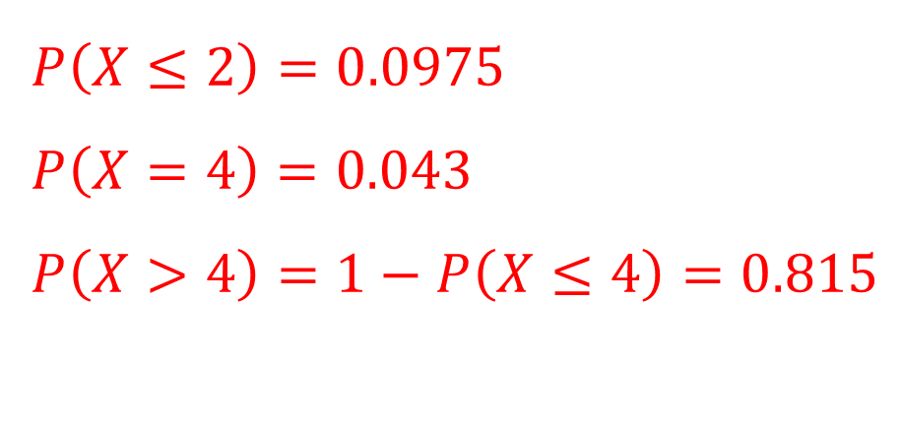
Practice:
Suppose that 5% of cereal boxes contain a prize and the other 95% contain the message, “Sorry, try again.” Consider the random variable X, where X = number of boxes purchased until a prize is found.
What is the probability that at most two boxes must be purchased?
What is the probability that exactly four boxes must be purchased?
What is the probability that more than four boxes must be purchased?
$P\left(X≤2\right)=0.0975$
$P\left(X=4\right)=0.043$
$P\left(X>4\right)=1−P\left(X≤4\right)=0.815$

